Slide 1

By Kieran Goldston
Click on Button to Continue

Slide 2
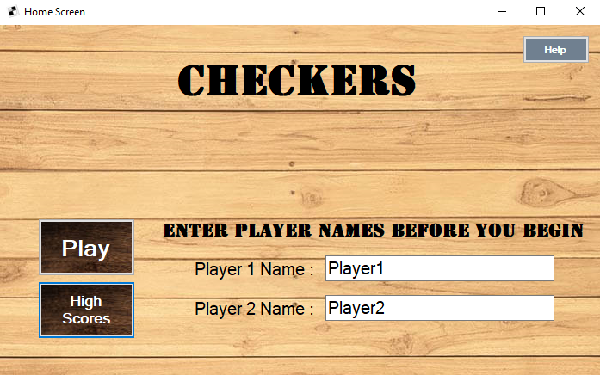
Once the players’ names have been entered click here to start
Before you begin, you should enter your name here, for this tutorial you will not have to do this
This is where you can access previously recorded scores

Slide 3

Piece Moving
Rules for piece moving:
Can only move diagonally
Can only move by one square (unless taking a piece)
Cannot move backwards (unless the piece is a king piece)
Cant go Backwards

Slide 4
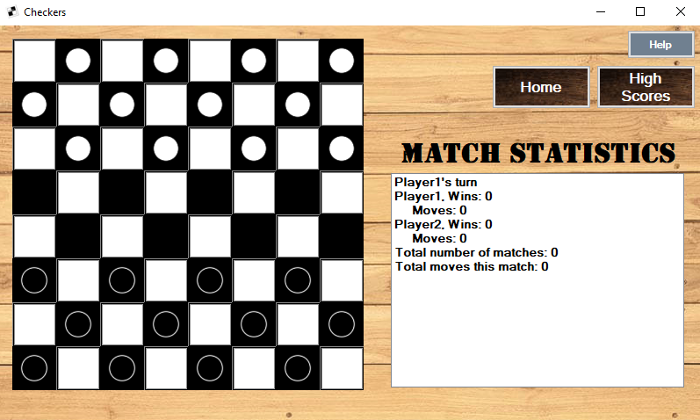
Piece Moving
Click Here to select piece

Slide 5
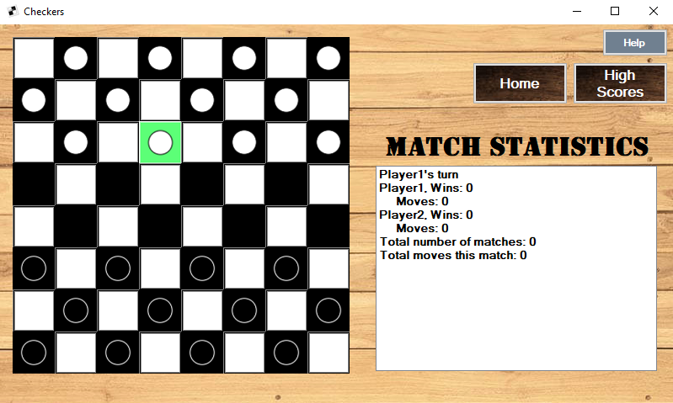
Piece Moving
Click Here to Move selected piece

Slide 6
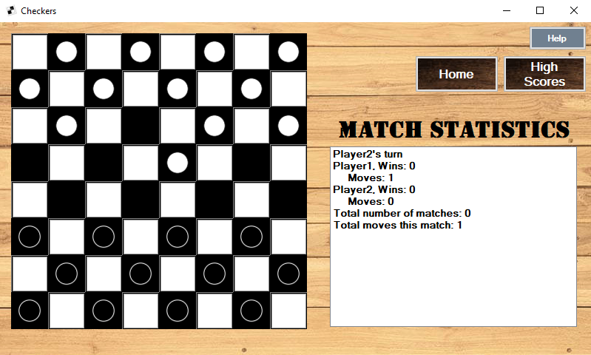
Piece Moving

Slide 7
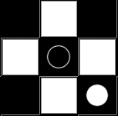
Taking Pieces
Jump over the opponents piece to take it
Rules for taking pieces:
Take a piece by jumping over it
Cannot jump over a piece onto a square that already has a piece on it
If you can take a piece you must take a piece
If you take a piece and have the ability to take another piece from that piece’s new position you may make another jump (you must do this until you cannot take anymore pieces)

Slide 8

Taking Pieces
Click Here to select piece
This piece must be taken

Slide 9
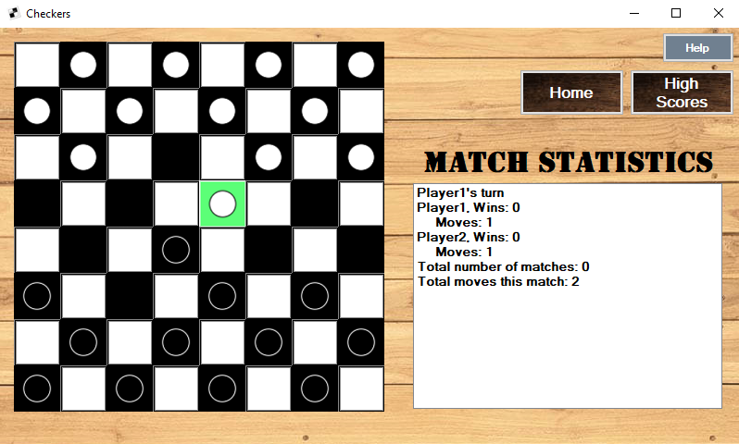
Taking Pieces
Click Here to Take piece outlined in red

Slide 10
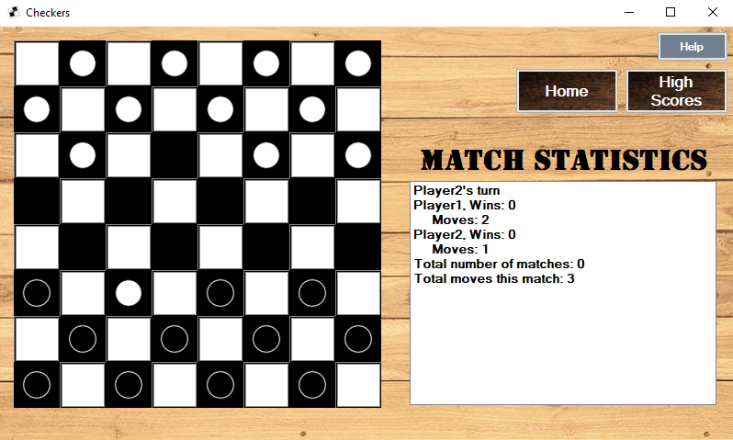
Taking Pieces

Slide 11

King pieces
Once a piece has reached the other side of the board, that piece becomes a king
A king piece may move in any direction (diagonally)

Slide 12
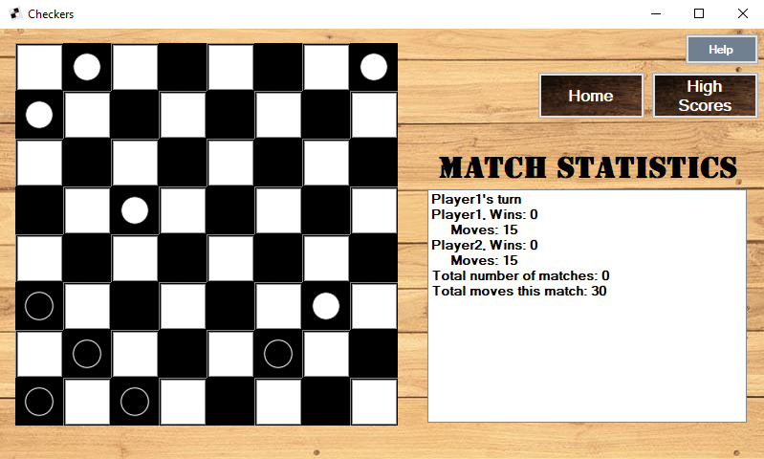
King Pieces
Click Here to select piece

Slide 13
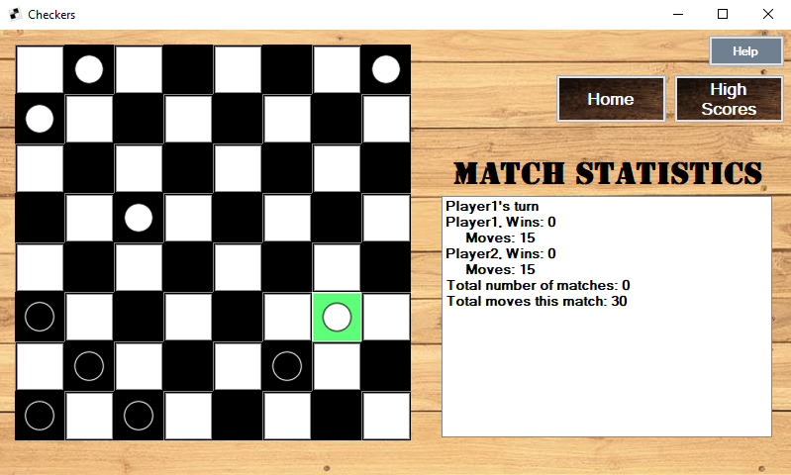
King Pieces
Click Here to take opponent’s piece, and king your own

Slide 14
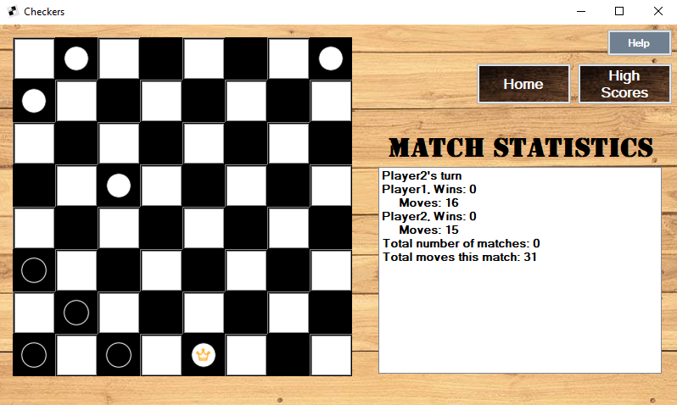
King Pieces
Great, now your piece can move in any direction!

Slide 15
Winning the game
A player wins the game when the opponent either does not have any pieces left of cannot make any valid moves
Upon winning, the winner will have their score recorded
The number of moves it took to win the match is what will be scored

Slide 16
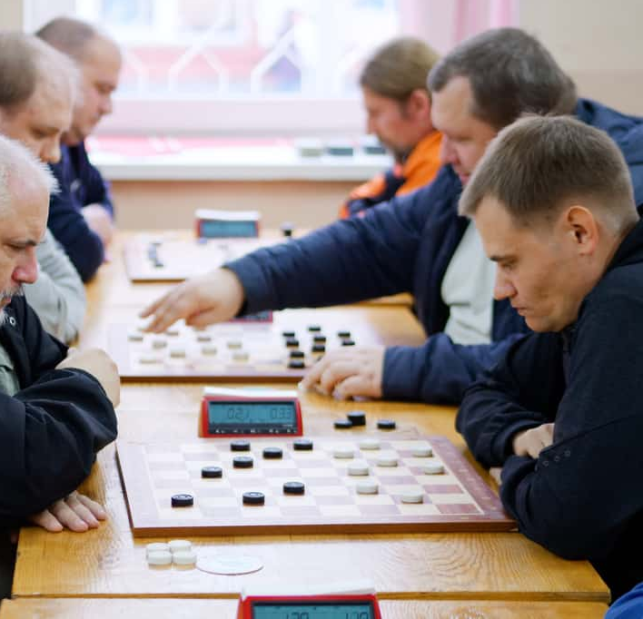
That’s It!
You are now ready to become the next checkers world champion!
Exit

